Slide 1
Welcome to
401MAN
The Business Environment

Slide 2
Welcome Back! And Welcome to CUW!
Who you are?
What are you looking to achieve through CU?
Something you are passionate about
Fun Fact about you
Most famous person you have ever met
Your personal Motto
Two personal objectives for 2025
Who is your most influential person?

Slide 3
What are we going to cover today?
Introduction to this module [401MAN – The Business Environment]
Overview of assignments 1 & 2
What is the business environment?

Slide 4
6 Week Plan
Week 1
Introduction to the module
What is the business environment?
Introduction to Environmental analysis.
What is an organisation and why do they exist?
Organisational theories.
Stakeholders
Week 2
The organisation, its people and culture.
Size, Structure and concentration levels.
Legal forms.
Managing and financing an organisation.
Week 3
Relationships and networks.
Globalisation
Assignment workshop!
Week 4
Markets
Supply and demand
Industry ad market structures
Political environment
Week 5
Technological environment
Ecological and social responsibilities
Culture and society
Week 6
Legal environment
Whole module review.
Assignment workshop

Slide 5
Learning Outcomes
Explore the organisational types and purposes of businesses from a range of sectors.
Demonstrate an understanding of the nature of the environment that organisations operate in.
Illustrate and explain the impact of environmental forces on organisations at a micro and macro level.
Assess the significance of impact of environmental forces at an organisation, market, sector or industry level.
Demonstrate an understanding of the requirements of a variety of stakeholders to a chosen organisation.
Measure and appraise the effectiveness of the responses of organisations to policy actions taken by key stakeholders.

Slide 6
Assignment 1 – 1,000 word report
Assignment 2 – 2,000 word report
Assignments
31/01/2025 7pm
21/02/2025 7pm

Slide 7
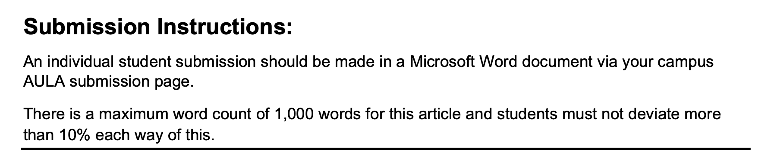
Assignment 1

Slide 8
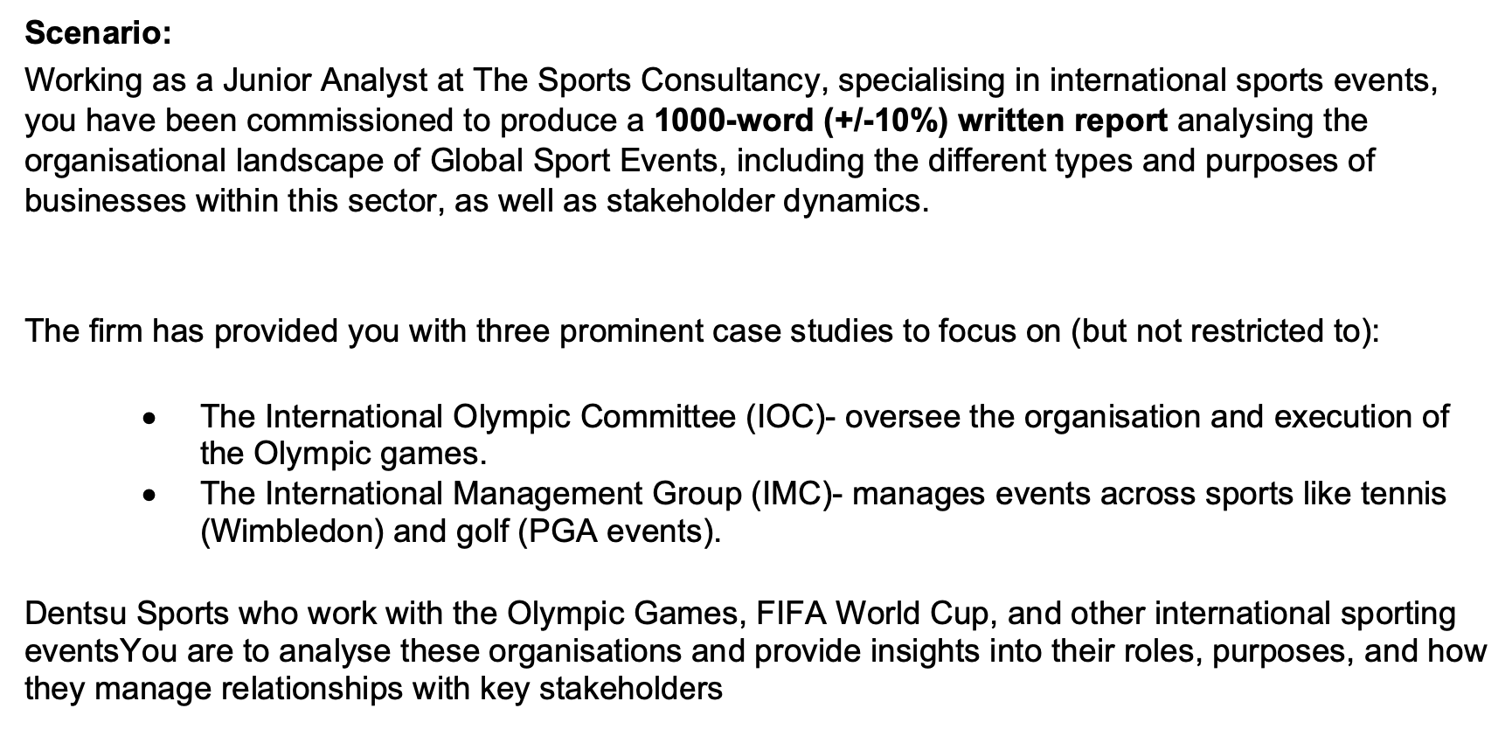
Assignment 1

Slide 9
Learning Outcomes
Explore the organisational types and purposes of businesses from a range of sectors.
Demonstrate an understanding of the nature of the environment that organisations operate in.
Illustrate and explain the impact of environmental forces on organisations at a micro and macro level.
Assess the significance of impact of environmental forces at an organisation, market, sector or industry level.
Demonstrate an understanding of the requirements of a variety of stakeholders to a chosen organisation.
Measure and appraise the effectiveness of the responses of organisations to policy actions taken by key stakeholders.

Slide 10

Essential Reading
https://cug-coventry.aula.education/#/dashboard/ba48cbdd-b378-4da4-ad6f-39920d9778d8/journey/materials/947295c3-e14d-421c-b465-0a6e9604f0cd
AULA – Reading Lists
BibliU – online access to the books

Slide 11
Break
20 Minutes
“What do we mean by .. The Business Environment?”

Slide 12
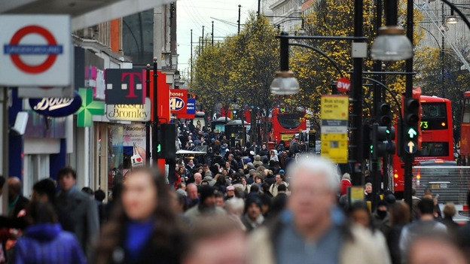
What do we mean by…
The Business Environment?

Slide 13
Business Environment means a collection of all individuals, entities and other factors, both internal and external, which may or may not be under the control of the organisation, but can affect its performance, profitability, growth and even survival.
Every business organisation operates in a distinctive environment.
Worthington, I., & Britton, C. (2018). The business environment. Pearson education.

Slide 14
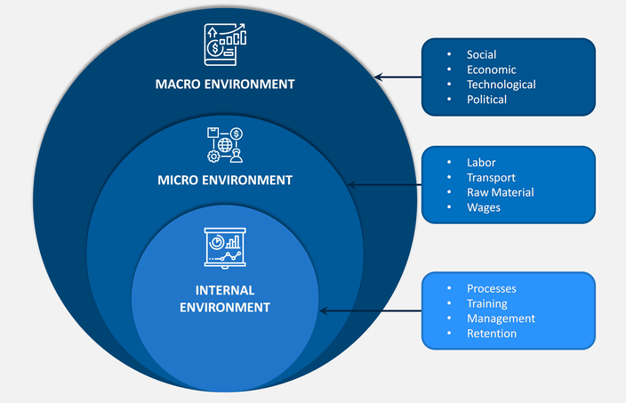
So what is the Environment?...

Slide 15
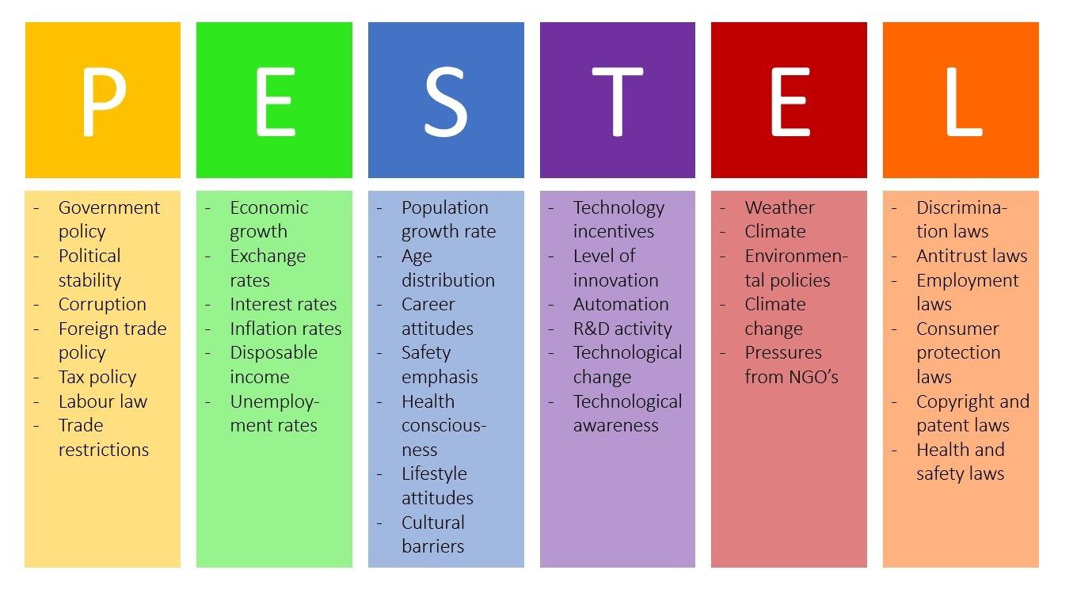
The Macro Environment
Political
Economic
Social
Technological
Environmental
Legal
Developed by Harvard professor Francis Aguilar in 1967

Slide 16

LoNGPEST or LoNGPESTLE
Macro environmental forces can operate at different levels
Local (Lo)
National (N)
Global (G)

Slide 17




Retailer - LoNGPESTEL
Local factors such as planning permission and local economic growth rates
National factors such as UK laws on retailer opening hours and trade descriptions legislation and UK interest rates
Global factors such as the opening up of new markets making trade easier. The entry of new member states into the European Union might make it easier to enter that market in terms of meeting the various regulations and provide new expansion opportunities. It might also change the labour force within the UK and recruitment opportunities.
Notes:
Take the example of a retailer wishing to start trading.

Slide 18


Slide 19

How to PESTEL ?
Impact and Period Each factor is considered in perspective (for example: short: 1-2 years, medium: 3-5 years, long: 6-10 years), and its impact on our organisation (from small to critical).
How can I know it? Use experts (internal or external), rely on reports
Are you sure? In your analysis, indicate your level of certainty as to the occurrence of the trend being reversed.
What next? Conclusion! Propose your tactics (short period of time to come) and strategy (far into the future) for dealing with the trends you have outlined

Slide 20
Group Task
Identify an organisation of your choice and conduct a LoNGPESTEL.
20 minutes
Groups to feedback to the group

Slide 21

SWOT

Slide 22
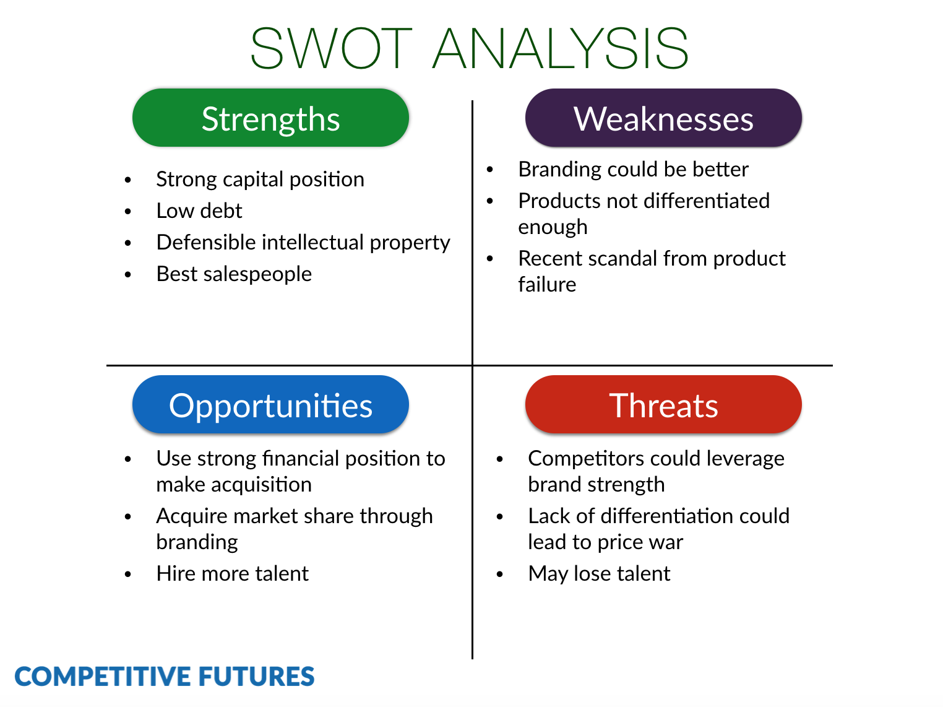
Strategic Direction
Developed by Dr. Andrew S. Humphrey in he 1970’s

Slide 23
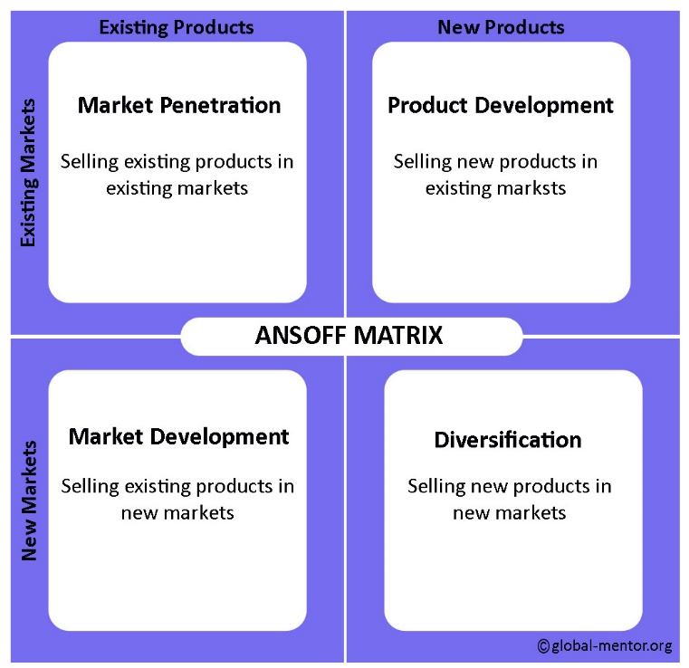
Strategic Direction – Growth
Developed by H. Igor Ansoff in 1957

Slide 24
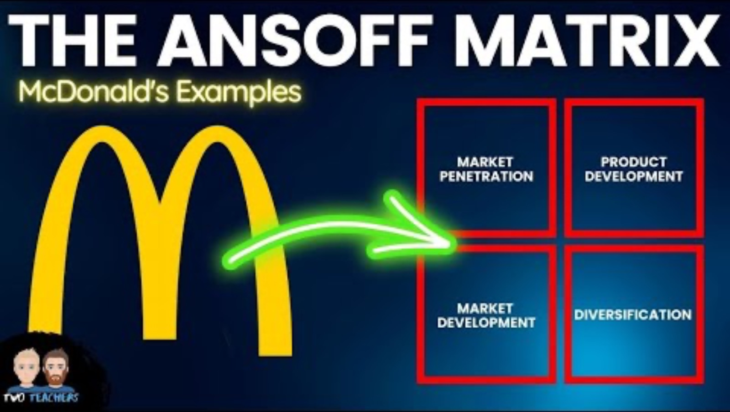

Slide 25
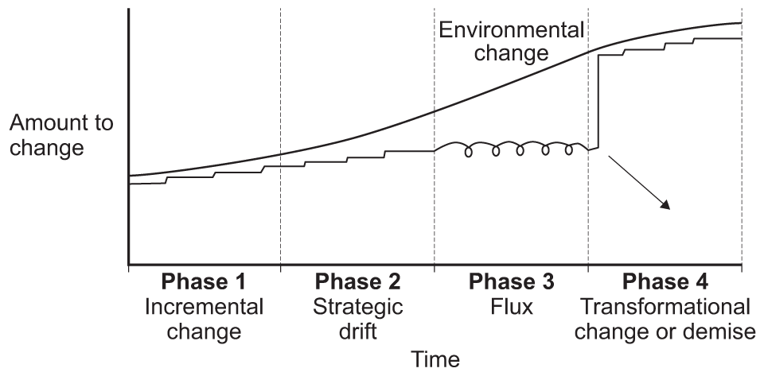
Strategic Drift …
Strategic drift occurs when the strategy pursued by a business no longer fits with the environment around it. What may have been appropriate at one point is no longer suitable as conditions have changed.

Slide 26

Strategic Drift …
Strategic drift occurs when the strategy pursued by a business no longer fits with the environment around it. What may have been appropriate at one point is no longer suitable as conditions have changed.

Slide 27

Strategic Drift…
“Strategy is the direction and scope of an organisation over the long term, which achieves advantage for the organisation through its configuration of resources within a changing environment and to fulfil stakeholder expectations”
Johnson and Scholes (2002) p10#]

Slide 28
Today we have covered:
Introduction to this module [401MAN – The Business Environment]
Overview of assignments 1
What is the business environment?

Slide 29
References
Boddy, D. (2017). Management: An Introduction (7th ed.). Harlow: Pearson.
Freeman, R.E. (1984) Strategic Management: A Stakeholder Approach, Boston: Pitman
Harrison, A (2014) Business Environment in a Global Context (2nd ed.) Oxford: Oxford University Press
JOHNSON, G., WHITTINGTON, R., and SCHOLES, K., (2011) Exploring Strategy 9th Ed Essex: Pearson Education Ltd.
Mullins, L. J. (2016). Management & Organisational Behaviour. (11th, Ed.) Harlow: Pearson.
Needle, D. & Burns, J. (2015). Business in Context. (7th ed.). Andover: Cengage.
Nutt, P.C. (2002) Why decisions fail. New York: Berrett-Koehler
Palmer, A & Hartley B. (2012) The Business Environment, (7th ed.) Maidenhead: McGraw Hil
Pestleweb (2014) PESTLE Analysis through Pictures: PESTLEWeb [online] available from <https://pestleanalysis.com/pestleweb/ > [21 October 2018]
Pitt, M R & Koufopoulos, D, (2012) Essentials of Strategic Management, London:Sage
Worthington, I. & Britton, C. (2015). The Business Environment (7th ed.). Harlow: Pearson.

